Slide 1

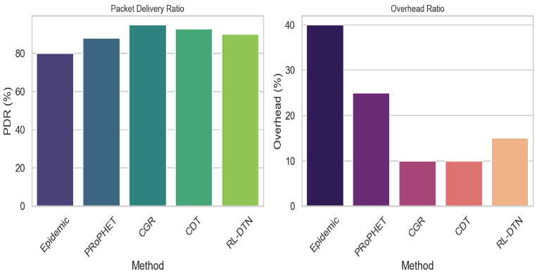
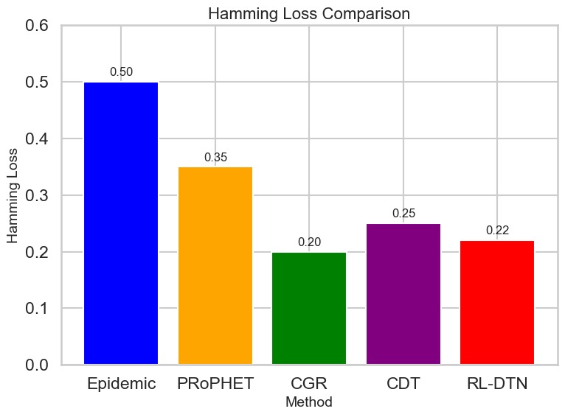
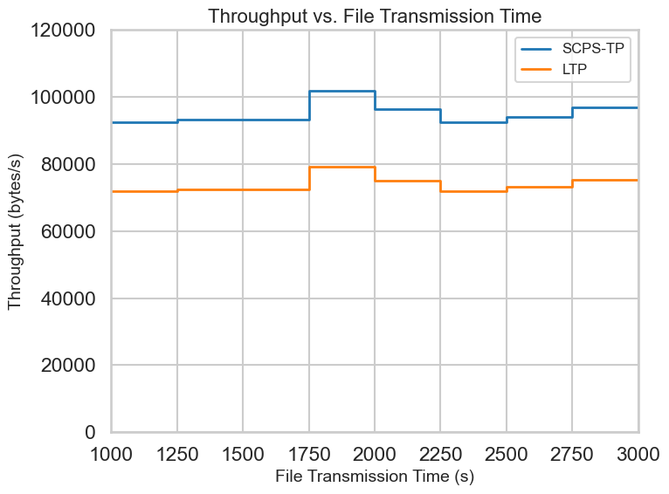
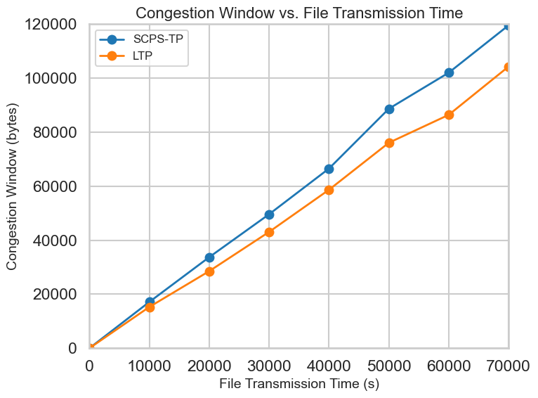
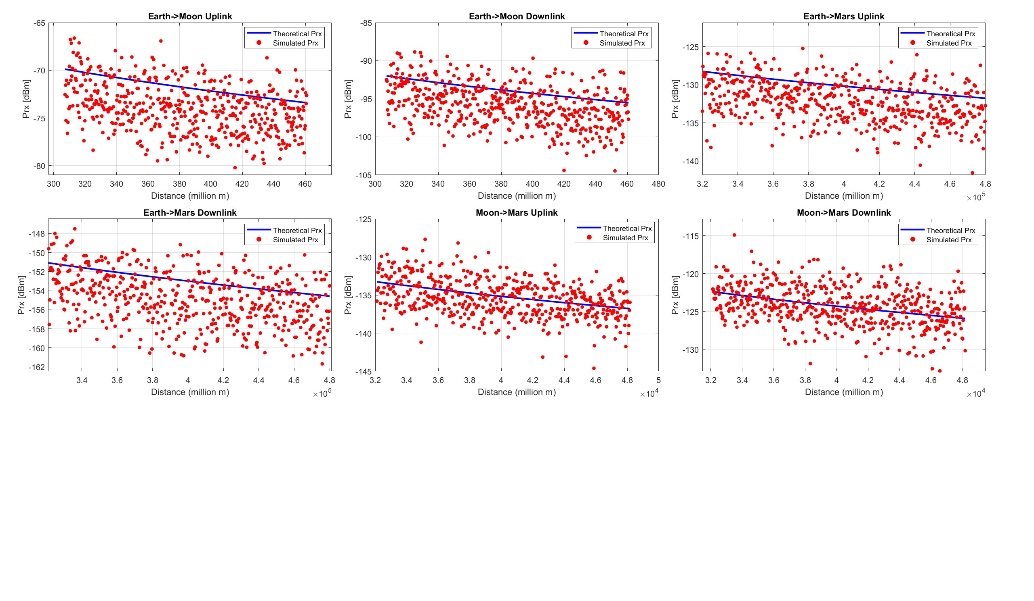
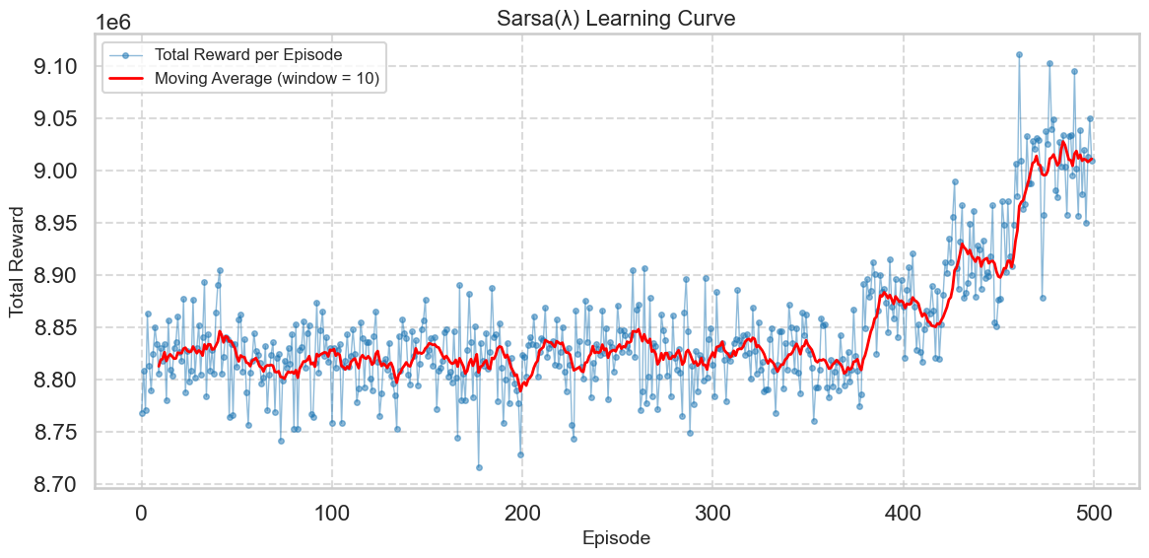
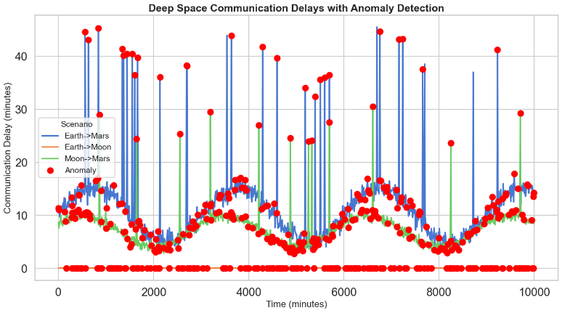
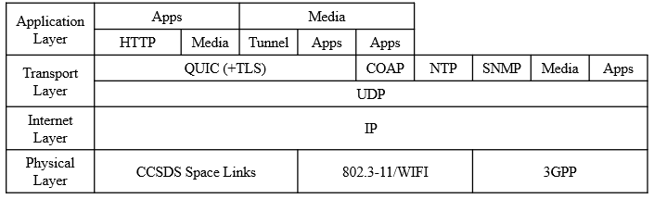
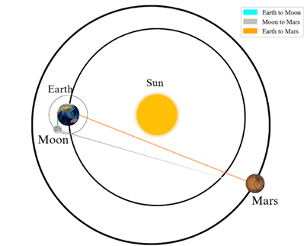
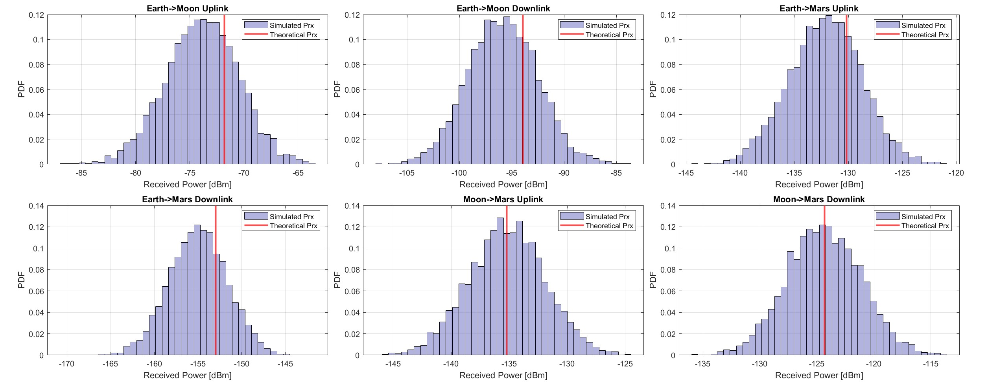
Deep Space Communication utilizing IP Stack Algorithm
Sivakrishna Manoj [RA2111053010013], Philius Mushahary [RA2111053010022]
Under the supervision of Dr Rama Rao T, Professor
Department of Electronics and Communication Engineering SRM Institute of Science and Technology,
Kattankulathur, Chennai 603203
ABSTRACT
Table II present the theoretical link budget analysis carried out based on the data from the antenna.
The received power is well within the acceptable threshold for all the three cases.
SCPS/IPv6 Implementation:
SCPS (9-byte) encapsulated in IPv6 (40-byte). Successfully builds, parses and recovers “Hello from deep space! This is a test message...”
Larger Payloads reduce overhead, improving efficiency.
RL-DTN validates learning-based approaches: Despite not knowing future contact opportunities, RL-DTN closely matches the performance of CGR, demonstrating the potential of reinforcement learning in DTNs.
The spike in the number of satellites being launched into orbit every year due to commoditization of space has led to traditional RF frequency bands used by these satellites, such as X-band to suffer from frequency congestion and delays. Existing technologies such as IP Stack can be adapted for deep space communication. This paper will suggest better communication methods which uses new state of the art technology utilizing IP stack for enhanced Earth-Mars Earth-Moon and Moon-Mars communication. The paper will also delve into the implementation of reinforcement learning based delay tolerant networks and a demonstration of protocols such as SCPS-TP and IPv6.
Payload (Bytes) | SCPS Packet (Bytes) | IPv6 Packet (Bytes) | SCPS overhead (%) | IPv6 overhead (%)
16 | 39 | 79 | 59.0 | 50.6
64 | 87 | 127 | 26.4 | 31.5
256 | 279 | 319 | 8.2 | 12.5
1024 | 1047 | 1087 | 2.2 | 3.7
4069 | 4119 | 4159 | 0.6 | 1.0
Parameters | Earth to Moon |  | Earth to Mars |  | Moon to Mars
 | Up-Link | Down-Link | Up-Link | Down-Link | Up-Link | Down-Link
Distance (m) | 3.84× 10⁸ | 3.84× 10⁸ | 4.00× 10¹¹ | 4.00× 10¹¹ | 4.014× 10¹⁰ | 4.014× 10¹⁰
Frequency (GHz) | 34.2 | 32 | 34.2 | 32 | 34.2 | 32
FSPL (dB) | 234.81 | 234.23 | 277.43 | 294.59 | 275.20 | 274.59
Data Rate (Mbps) | 4.5 | 4.5 | 3 | 3 | 4.5 | 4.5
Transmitter Power (dBm) | 73 | 50 | 73 | 50 | 50 | 60
Transmitter Gain (dBi) | 47 | 46.7 | 47 | 46.7 | 47 | 46.7
Receiver Gain (dBi) | 47 | 47.6 | 47 | 47.6 | 47 | 47.6
Losses (dB) | 4 | 4 | 2 | 2.71 | 4 | 4
Receiver Power (dBm) | -79.21 | -101.33 | -112.43 | -153.19 | -135.20 | -124.89
Table III: SCPS/IPv6 Overhead results
SCPS-TP Performance vs LTP Performance (Fig. 5 & 6):
SCPS-TP’s superior performance stems from its advanced congestion control mechanisms, likely including selective negative acknowledgments (SNACKs) and rate-based control strategies.
Fig. 9: Comparison of RL-DTN against existing models
Fig. 10: Comparison of Hamming Loss between existing models
Table II: Link Budget Analysis
CONCLUSION
REALISTIC CONSTRAINTS
This project presents a comprehensive analysis of a Ka-Band and IP Stack based communication system which utilizes reinforcement learning and isolation forest algorithms for optimal routing and anomaly detection. The Monte Carlo simulations carried out on MATLAB prove the high gain antenna to be a suitable system. The RL model is proven to be able to train itself to find the most optimal routes. The isolation forest algorithm is successfully able to isolate and detection anomalies in the synthetic dataset. IPv6 and SCPS TP protocols were successfully demonstrated with SCPS-TP performing better than LTP in deep space conditions and RL-DTN is shown to be a balance between existing DTN protocols.
OBJECTIVES
Extreme propagation delays due to vast interplanetary distances particularly in the Earth–Mars link pose a major hurdle. These delays the management of acknowledgments and retransmission strategies.
Lack of real-time space communication data, as agencies like NASA and SpaceX keep their mission data highly secured and inaccessible to the public.
Develop an IP-based communication model for deep space using modern protocols like IPv6, UDP, and QUIC, thus implement SCPS-TP over IPv6 to ensure reliable packet parsing across long-delay links.
Analyze and compare link budgets with Monte Carlo simulated results.
Apply reinforcement learning (SARSA-λ) for intelligent routing in delay-tolerant network (DTN).
Also integrate anomaly detection to identify communication disruptions using isolation forest.
Evaluate performance metrics across multiple routing protocols.
Our aim is a future-proof deep-space communication framework.
Fig. 5: Throughput vs File Transmission Time
Fig. 6: Congestion Window vs File Transmission Time
RL BASED DTN
ENGINEERING STANDARDS
Reinforcement Learning based DTN (Fig. 7):
Modelled in Python, optimizes routing using a reward-penalty system SARSA-λ (State-action-reward-state-action).
Initial Temporal Difference (TD) showed high fluctuation, showing the agent’s early exploration of suboptimal routes.
Over time, the learning curve smoothed out, depicting convergence to a stable and effective routing policy.
Anomaly Detection with Isolation Forest (Fig. 8):
Detects outliers in communication delays and unusual spikes/dips in all 3 links.
ITU-R SA.2167 standard
IETF RFC 8200 IPv6
SCPS-TP Space Communication Protocol Specification–Transport Protocol
REFERENCES
RESULTS AND DISCUSSION
[1 ] M. Blanchet and Viagénie, “Beyond Earth: Exploring the Future of Deep Space Communications”, IEEE CTN, May 2024
[2] R. Dudukovich and C. Papachristou, “Delay tolerant network routing as a machine learning classification problem.” 2018 NASA/ESA Conference on Adaptive Hardware and Systems (AHS). IEEE, pp. 96-103, November 2018, doi: https://doi.org/10.1109/ahs.2018.8541460.
[3] R. Wang, and S. Horan. "Protocol testing of SCPS-TP over NASA's ACTS asymmetric links." IEEE Transactions on Aerospace and Electronic Systems vol 45, no, pp. 790-798, April 2009, doi: 10.1109/TAES.2009.5089562.
[4] R. S. Sutton, “Reinforcement Learning: An Introduction: An Introduction”. Cambridge, Massachusetts: The Mit Press, 2018.
METHODOLOGY
Monte Carlo Scatter Analysis:
Monte Carlo Simulation models randomness in signal propagation. Simulated values closely follow the theoretical curve, showing high correlation.
The scatter plots shows minimal variation from the theoretical curve (Fig.3). The histogram peak lies in the theoretical received power value (Fig. 4)
Antenna Specifications:
Ka-Band Parabolic Reflector Antenna implemented with
MATLAB's Antenna Designer toolbox.
(See Table I)
Antenna Type | Parabolic Reflector
Frequency | 32 to 34.2 GHz
Diameter | 1.5 m
Focal Length | 0.7
f/d ratio | 0.467 m
Exciter | Conical horn
Aperture radius of the exciter | 0.102 m
Table I: Antenna Specifications
Fig. 7: Learning curve of RL based DTN
Fig. 8: Anomaly Detection using Isolation Forest
Fig. 3: Monte Carlo Scatter plot
Packet Delivery Ratio (PDR) & Overhead Ratio Analysis (Fig. 9):
RL-DTN: Balanced performance, better than Epidemic & PRoPHET in both areas.
RL-DTN is efficient without rigid scheduling (CGR) or vast labelled data (CDT).
Hamming Loss Comparison (Fig. 10):
The CGR approach results in a Hamming Loss of 0.20, while the RL-DTN achieves 0.22 despite having no prior schedule awareness.
Link Case Studies (Fig. 2):
Case A: Earth-Moon direct link.
Case B: Earth-Mars direct link.
Case C: Moon-Mars direct link.
Emphasis on direct satellite-to-satellite communication.
Fig. 1: IP Stack for Deep Space Communication
CONFERENCE PUBLICATION
Our paper entitled ‘Deep Space Communication utilizing IP Stack and Reinforcement Learning Algorithm’ was presented at IEEE co-sponsored International Conference on Wireless Communications, Signal Processing and Networking (WISPNET) 2025 on 22nd March 2025.
Fig. 2: Interplanetary Links
Fig. 4: Monte Carlo Histogram

